Slide 1
Databases 2
Database Backup, Recovery and Concurrency

Slide 2
Overview
Backup
Recovery
Transactions
Concurrency
Conclusion

Slide 3
Why Backup?
Protect databases against data loss by failures
Causes for dataloss:
Media failure
User errors
Hardware failures, a damaged disk drive
Natural disasters
Useful for routine administrative purposes, database mirroring, archiving
Notes:
Symptoombestrijding? Je kan toch ook de onderliggende problemen oplossen zodat backups niet nodig zijn?
Symptom control? You can also solve the underlying problems so that backups are not necessary, right?

Slide 4
Backups
Database backups
Full backup
Differential backup
Partial backups
Partial Backup
Differential partial backup
File backups
File Backup
Differential file backup
Transaction Log Backups
Copy-Only backups
Notes:
Under the full recovery model or bulk-logged recovery model, regular transaction log backups (or log backups) are required. Each log backup covers the part of the transaction log that was active when the backup was created, and it includes all log records that were not backed up in a previous log backup. An uninterrupted sequence of log backups contains the complete log chain of the database, which is said to be unbroken. Under the full recovery model, and sometimes under the bulk-logged recovery model, an unbroken log chain lets you to restore the database to any point in time.
Before you can create the first log backup, you must create a full backup, such as a database backup. Thereafter, backing up the transaction log regularly is necessary, not only to minimize work-loss exposure but also to enable truncation of the transaction log.
Usually, taking a backup changes the database and affects how later backups are restored. However, occasionally, it is useful to take a backup for a special purpose without affecting the overall backup and restore procedures for the database. For this purpose, copy-only backups were introduced

Slide 5
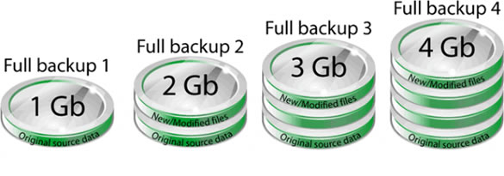
Full Backup
Notes:
A full backup contains all the data in a specific database or set of filegroups or files, and also enough log to allow for recovering that data.

Slide 6
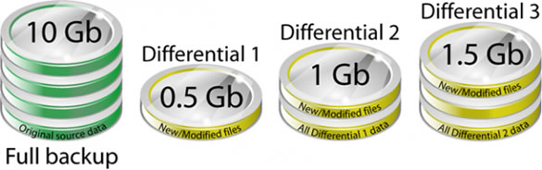
Differential Backup
Notes:
A differential backup is based on the latest full backup of the data. This is known as the base of the differential, or the differential base. A differential base is a full backup of read/write data. A differential backup contains only the data that has changed since the differential base. Typically, differential backups that are taken fairly soon after the base backup are smaller and faster to create than the base of a full backup. Therefore, using differential backups can speed up the process of making frequent backups to decrease the risk of data loss. Usually, a differential base is used by several successive differential backups. At restore time, the full backup is restored first, followed by the most recent differential backup.
Over time, as a database is updated, the amount of data that is included in differential backups increases. This makes the backup slower to create and to restore. Eventually, another full backup will have to be created to provide a new differential base for another series of differential backups.

Slide 7

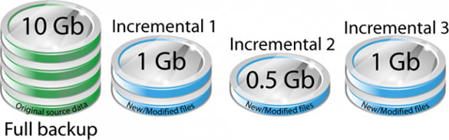
Incremental Backup
Notes:
Incremental backup stores all data changed since the last full, differential or incremental backup. It takes the least time for backing up, but a lengthy job for restoring. The backup is the fastest and it saves storage space but the recovery is the slowest ( compared with full backup or differential backup ). Each backup increment can store a different version for databases but to restore the latest version of a database, the last full backup and all of the incremental backups must be found first.
When restoring from incremental backup, you need the last full backup and all of the incremental backups you've made since the last full backup. So it takes more time to restore.

Slide 8
Data Protection Tools
Recovery
Concurrency

Slide 9
Data Protection
Protection against risks of:
System crash: DB in unclear state
Two active programs influence each other
Unauthorized user
Changes
Notes:
Two active programs -> Wrong results after active programs
Unauthorized user -> View secure / sensitive data
Changes -> Incorrect state

Slide 10
Data Protection
Precautions:
Recovery
Concurrency
Security
Integrity
Notes:
Recovery -> After crash
Concurrency -> access data at the same time
Security -> Authorization of users
Integrity -> Only correct changes are allowed

Slide 11
Recovery

Slide 12
Database recovery
Mechanisms for restoring database quickly and accurately after loss or damage.

Slide 13
Recovery
What does it do?
Brings back the db in a correct state after a malfunction.
What is needed?
Redundancy, save data on 2 locations
Transactions
Notes:
Redundancy, save data on two locations, In the database and in a logfile

Slide 14
Transactions (1)
What is a transaction?
Logical unit of work that is executed as a whole.
Transactions are:
Atomic
Consistent
Isolated
Durable
Notes:
ACID: Atomic =“All or nothing”; Consistent = From valid to valid db state; Isolated = Two query’s at a time results in waiting for the first to be done; Durable = once a transaction is committed, it will always be commited
Atomicity requires that each transaction be "all or nothing": if one part of the transaction fails, then the entire transaction fails, and the database state is left unchanged. An atomic system must guarantee atomicity in each and every situation, including power failures, errors and crashes. To the outside world, a committed transaction appears (by its effects on the database) to be indivisible ("atomic"), and an aborted transaction does not happen.
The consistency property ensures that any transaction will bring the database from one valid state to another. Any data written to the database must be valid according to all defined rules, including constraints, cascades, triggers, and any combination thereof. This does not guarantee correctness of the transaction in all ways the application programmer might have wanted (that is the responsibility of application-level code), but merely that any programming errors cannot result in the violation of any defined rules.
The isolation property ensures that the concurrent execution of transactions results in a system state that would be obtained if transactions were executed sequentially, i.e., one after the other. Providing isolation is the main goal of concurrency control. Depending on the concurrency control method (i.e., if it uses strict - as opposed to relaxed - serializability), the effects of an incomplete transaction might not even be visible to another transaction.plication-level code), but merely that any programming errors cannot result in the violation of any defined rules.
The durability property ensures that once a transaction has been committed, it will remain so, even in the event of power loss, crashes, or errors. In a relational database, for instance, once a group of SQL statements execute, the results need to be stored permanently (even if the database crashes immediately thereafter). To defend against power loss, transactions (or their effects) must be recorded in a non-volatile memory.

Slide 15
Transactions (2)
Notes:
Both updates are executed
Both updates are not executed

Slide 16
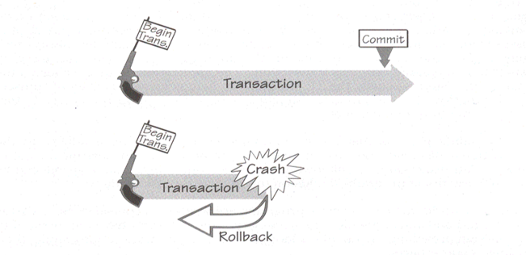
Transactions (3)
Notes:
Atomic, so all or nothing, when one action fails, a rollback is done to the start of the transaction

Slide 17
Recovery based on transactions
Two types of crashes
System failure: 'Soft' crash(no physical damage to DB)
Recovery is done automatically
Media failure: 'Hard' crash(physical damage to DB)
Restore database from dump (backup)
Log is used to execute all committed transactions

Slide 18
Recovery of soft crash(1)
Checkpoint: commited tx’s written to disk
T2 and T4 must be done again (REDO)
T3 and T5 must be cancelled (UNDO)
Time
T1
T2
T3
T4
T5
checkpoint (tc)
System Failure (tf)
Notes:
Checkpoint = wat er op dit moment opgeslagen is.
T2 en T4 zijn niet meegenomen in checkpoint, dus opnieuw doen.
T3 en T5 zijn zijn transacties die niet klaar waren, dus annuleren.
Checkpoint = what is currently stored.
T2 and T4 are not included in checkpoint, so do it again.
T3 and T5 are his trades that were not ready, so cancel.

Slide 19
Recovery of soft crash(2)
Put active transactions in UNDO list (T2, T3)
Add for every BEGIN the transactions to the UNDO list (T4, T5)
Move every COMMIT transaction to REDO List (T2, T4)
Do all UNDO’s from tf to tc.
Do all REDO’s from tc to tf.
Time
T1
T2
T3
T4
T5
checkpoint (tc)
System Failure (tf)

Slide 20
Question
Is an update 1st written to the DB or to the logfile?
To the logfile!!
Notes:
Wat doen jullie. Loggen jullie eerst en dan de actie, of eerst de actie en dan loggen?
What will you do. Do you log first and then the action, or first the action and then log?

Slide 21
SQL Server Transaction
BEGIN TRANSACTION [Tran1]
BEGIN TRY
INSERT INTO [Test].[dbo].[T1]
([Title], [AVG])
VALUES ('Tidd130', 130), ('Tidd230', 230)
UPDATE [Test].[dbo].[T1]
SET [Title] = N'az2' ,[AVG] = 1
WHERE [dbo].[T1].[Title] = N'az’
COMMIT TRANSACTION [Tran1]
END TRY
BEGIN CATCH
ROLLBACK TRANSACTION [Tran1]
END CATCH
GO
SET XACT_ABORT ON
BEGIN TRANSACTION
INSERT INTO [Test].[dbo].[T1]
([Title], [AVG])
VALUES ('Tidd130', 130), ('Tidd230', 230)
UPDATE [Test].[dbo].[T1]
SET [Title] = N'az2' ,[AVG] = 1
WHERE [dbo].[T1].[Title] = N'az’
COMMIT TRANSACTION

Slide 22
Journalizing

Slide 23
Journalizing
Maintain audit trail of transaction and database changes
In case of failure:
Database state can be re-established using information in journals together with most recent complete backup.
2 basic logs or journals:
Transaction log – Record of essential data for each transaction
Database changelog – Images of updated data
Notes:
Transaction log: Transaction code, action time, terminal no / user ID, input dat values, records accessed & modified and old and new values
Database Change log: Before image and after image.

Slide 24
Concurrency
Access to data for multiple transactions at the same time
Concurrency control: needed to prevent that transactions influence each other

Slide 25
Concurrency problems: dirty read
p(A) | User A | Time | User B | p(B)
100 | - |  | - | 100
100 | - |  |  | 100
100 | - | T1 | UPDATE p | 125
100 |  |  | - | 125
125 | Retrieve p | T2 | - | 125
125 | - |  | - | 125
125 | - | T3 | ROLLBACK | 100
175 | UPDATE p(p->p+50) |  | -
175 | COMMIT |  | -
175 | - |  | -
Notes:
Dirty read = Het lezen van een waarde die nog niet gecommit is. Dirty read = Reading a value that has not yet been committed.
User B updates p from 100 to 125;
User A retrieves p: 125
User B rolls back, so p is set to 100 again
User A increases p with 50. 125 + 50 = 175.
What should p actually be?

Slide 26
Concurrency problems: non repeatable read
p(A) | User A | Time | User B | p(B)
100 | - |  | - | 100
100 | Retrieve p | T1 |  | 100
100 | - | T2 | UPDATE p | 125
100 | - |  | - | 125
125 | Retrieve p | T3 | - | 125
125 | - |  | - | 125
125 | - | T4 | COMMIT | 125
125 | COMMIT |  | -
 | - |  | -
 | - |  | -
Notes:
Repeatable read = Twee verschillende gecommitte waardes lezen. Repeatable read = Read two different committed values.
User A reads on t1 and t3 two different values of p

Slide 27
Concurrency problems: phantoms
p(A) | User A | Time | User B
 | - |  | -
P1..p5 | Retrieve p | T1
P1..p5 | - | T2 | INSERT p6
P1..p5 | - |  | COMMIT
P1..p6 | Retrieve p | T3 | -
P1..p6 | - |  | -
P1..p6 | - | T4 | -
P1..p6 | COMMIT |  | -
 | - |  | -
 | - |  | -
Notes:
T1 reads rows from table based on some condition (WHERE);
T2 inserts a new row that satisfies that WHERE condition;
If T1 is repeated, it will see a row that did not exists earlier.

Slide 28
Concurrency problems: Causes
Transactions on the same data are using each others intermediate results
Overlapping instead of sequential

Slide 29
Concurrency problems: Solution
Locking
Table
Page
Record
Field
Notes:
This is called lock granularity

Slide 30
Locking
lock(A) | transaction A | transaction A | lock(B)
 | - | - | -
 | - | BEGIN
 | - | UPDATE account:= account -100 | L?
 | BEGIN | - | L
L? | UPDATE account:= account + 50 | - | L
L? | - | COMMIT | L
L? | - | - | -
L? | - | - | -
L | COMMIT | - | -
 | - | - | -

Slide 31
Locking Shared en eXclusive(1)
Multiple transactions can have an S-lock (Shared) on the same record
One transaction can have an X-lock (eXclusive) on a record
Shared ➔ Can read, cannot update
eXclusive ➔ One transaction, one row
Notes:
Shared = can read, cannot update.
eXclusive = only one transaction; only on one row

Slide 32
Locking Shared en eXclusive(2)
Use S-lock for reading(only when no one has X-lock)
Use X-lock for writing (only when no one has a lock)
Release locks when ending a transaction (ROLLBACK or COMMIT)

Slide 33
Locking: dirty read
Lock(A) | User A | Time | User B | Lock(B)
 | - |  | -
 | - |  | BEGIN
 | - | T1 | UPDATE p | X
 | BEGIN |  | - | X
S? | Wait | T2 | - | X
S? | Wait |  | - | X
S? | Wait | T3 | ROLLBACK
S | RETRIEVE P | T4 | -
X | UPDATE p(p->p+50) |  | -
 | COMMIT |  | -
Notes:
User A reads on t2 a value that is not committed and uses it for an update!!!

Slide 34
Two-phase locking
Always serializable
Always recoverable
But can lead to a deadlock
Notes:
2 transactions at the same time must have the same result when transactions are performed after eachother.

Slide 35
Locking: Deadlock
Lock(A) | User A | Time | User B | Lock(B)
 | - |  | -
S | RETRIEVE P | T1 | -
S |  | T2 | RETRIEVE P | S
S | - |  | - | S
X? | UPDATE p? | T3 | - | S
 | Wait |  | - | S
 | Wait | T4 | UPDATE p? | X?
 | Wait |  | Wait
 | Wait |  | Wait
 | Wait |  | Wait
Notes:
User A reads on t2 a value that is not commited and uses it for an update!!!

Slide 36
Deadlock solutions
Detect deadlocks
Assign a victim and do a ROLLBACK
Inform application
Or
Restart transaction automatically

Slide 37
Concurrency Control
What should you do as a programmer?
Almost nothing…
Choose isolation level or take it into account
Isolation levels:
Isolation level | Dirty Read | Nonrepeatable read | Phantom
Read Uncommited | Y | Y | Y
Read committed | N | Y | Y
Repeatable Read | N | N | Y
Serializable | N | N | N
Notes:
Only Serializable prevents all the problems

Slide 38
Conclusion
Always choose serializable isolation level until there are performance problems
When a lower isolation level is chosen, know the effects

